Slide 1


Hosting a Static Website Using Amazon S3
Presented by: Chandan Nayak
Course: Computer Science Engineering

Slide 2
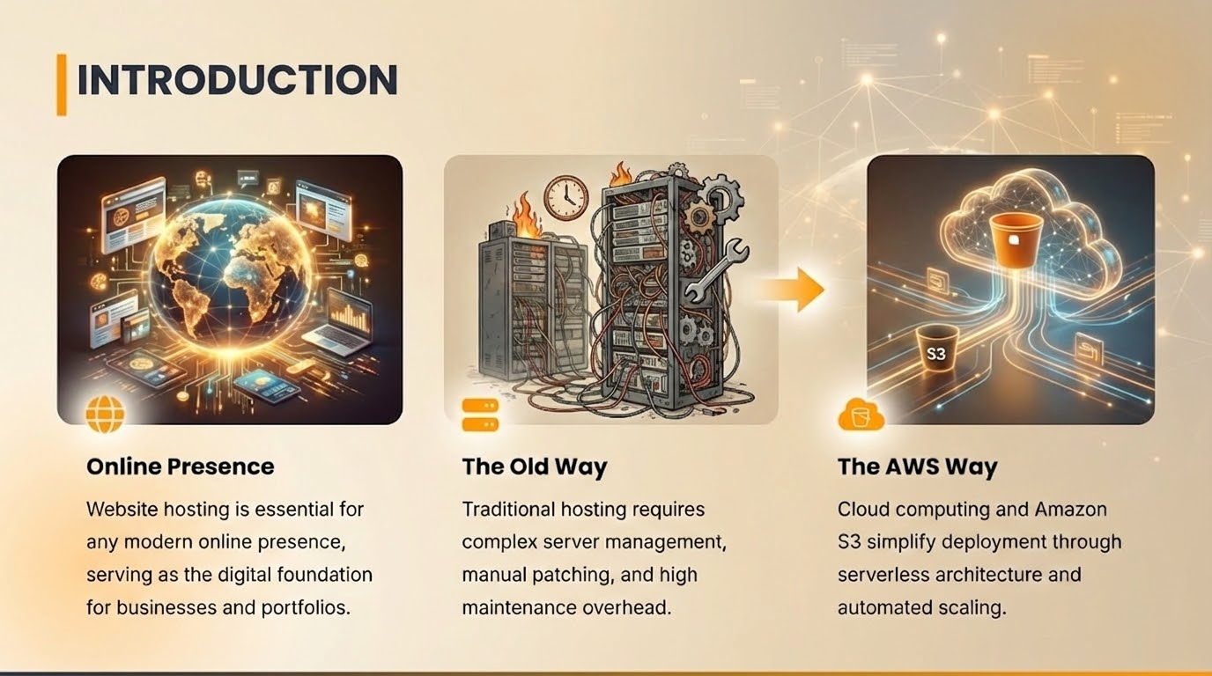

Slide 3
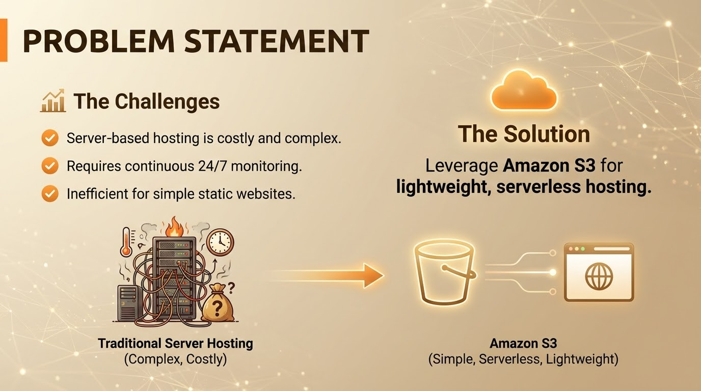

Slide 4
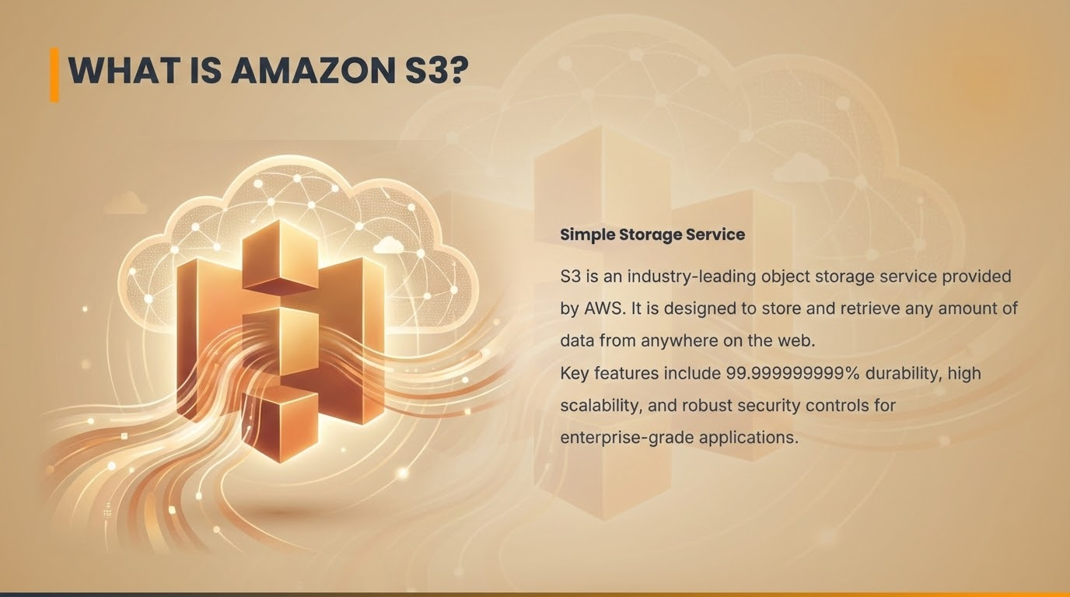

Slide 5





WHAT IS A STATIC WEBSITE?
Fixed Content
Core Technologies
No Backend
Displays the same content for every visitor without server-side processing.
Uses standard web technologies: HTML for structure, CSS for style, and JavaScript for interactivity.
Directly served to the browser, making it incredibly fast and secure from injection attacks.

Slide 6
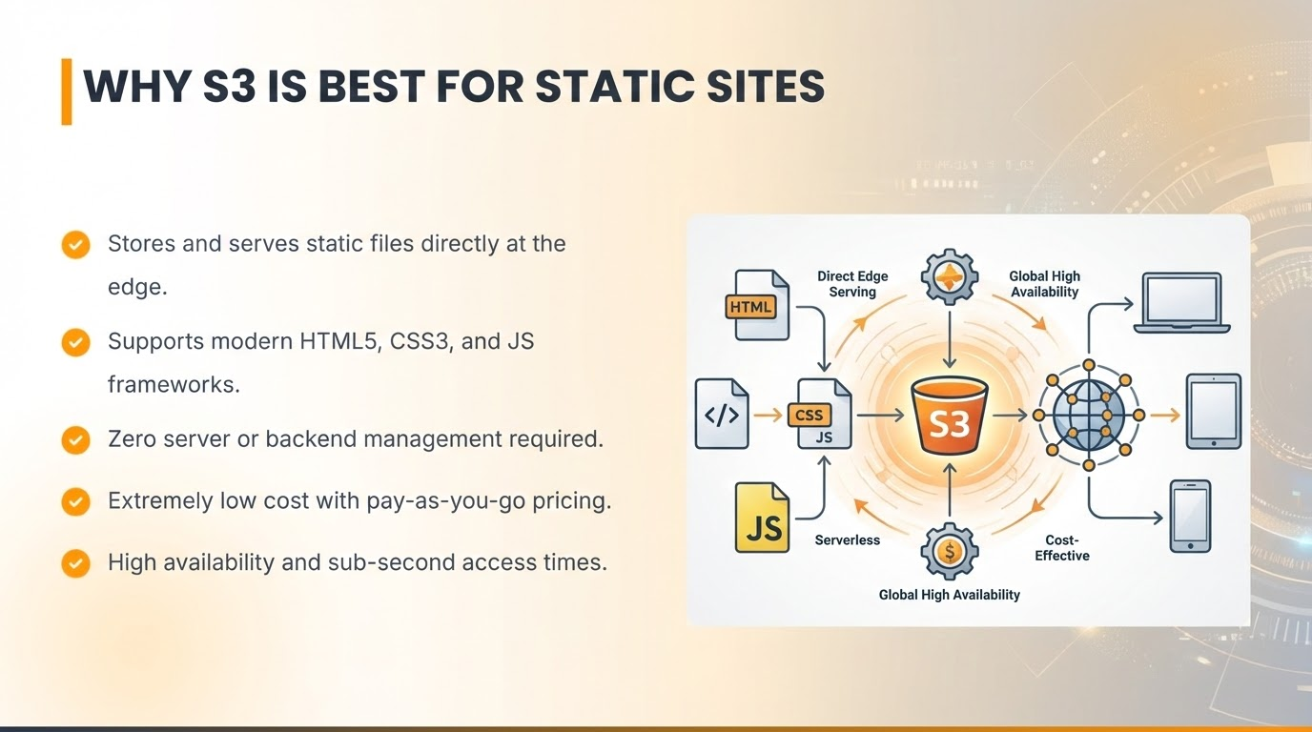

Slide 7

PROJECT OBJECTIVE
Host a fully functional website without a server.
0%
Master the Amazon S3 ecosystem.
Learn modern Serverless Architecture.
Server Management
Build a foundation in AWS Cloud concepts.

Slide 8
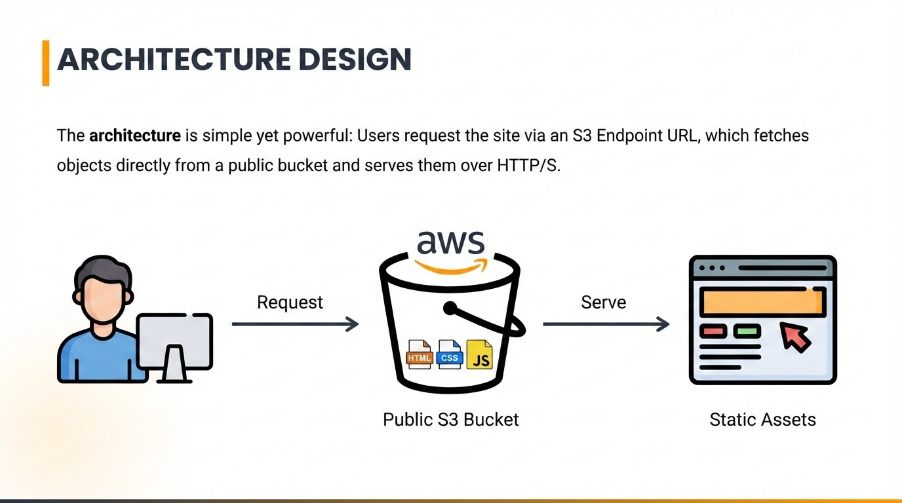

Slide 9
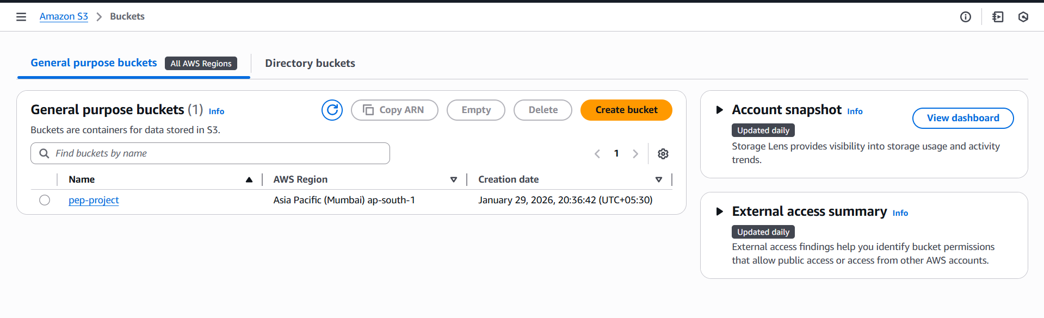

STEP 1: CREATE S3 BUCKET

Slide 10
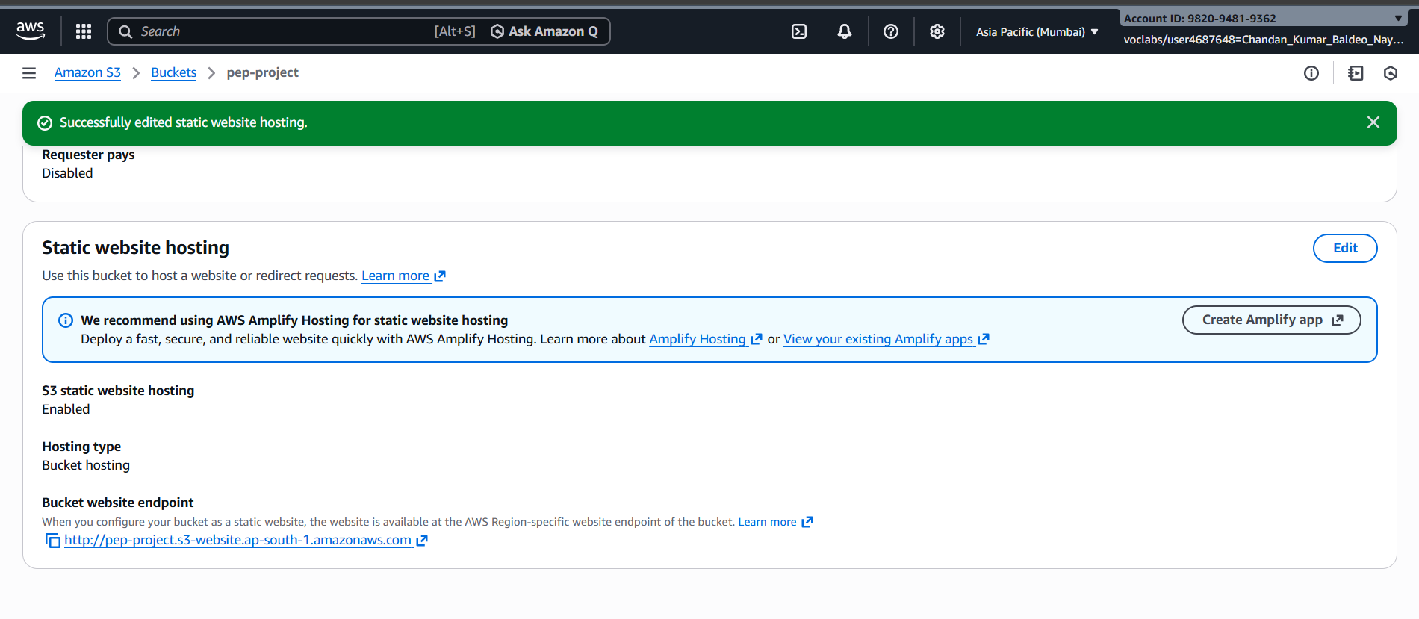

STEP 2: ENABLE WEB HOSTING

Slide 11
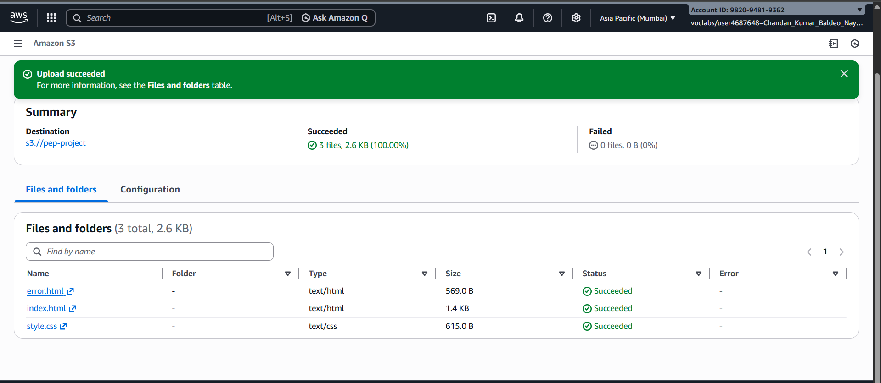

STEP 3: UPLOAD WEBSITE FILES

Slide 12
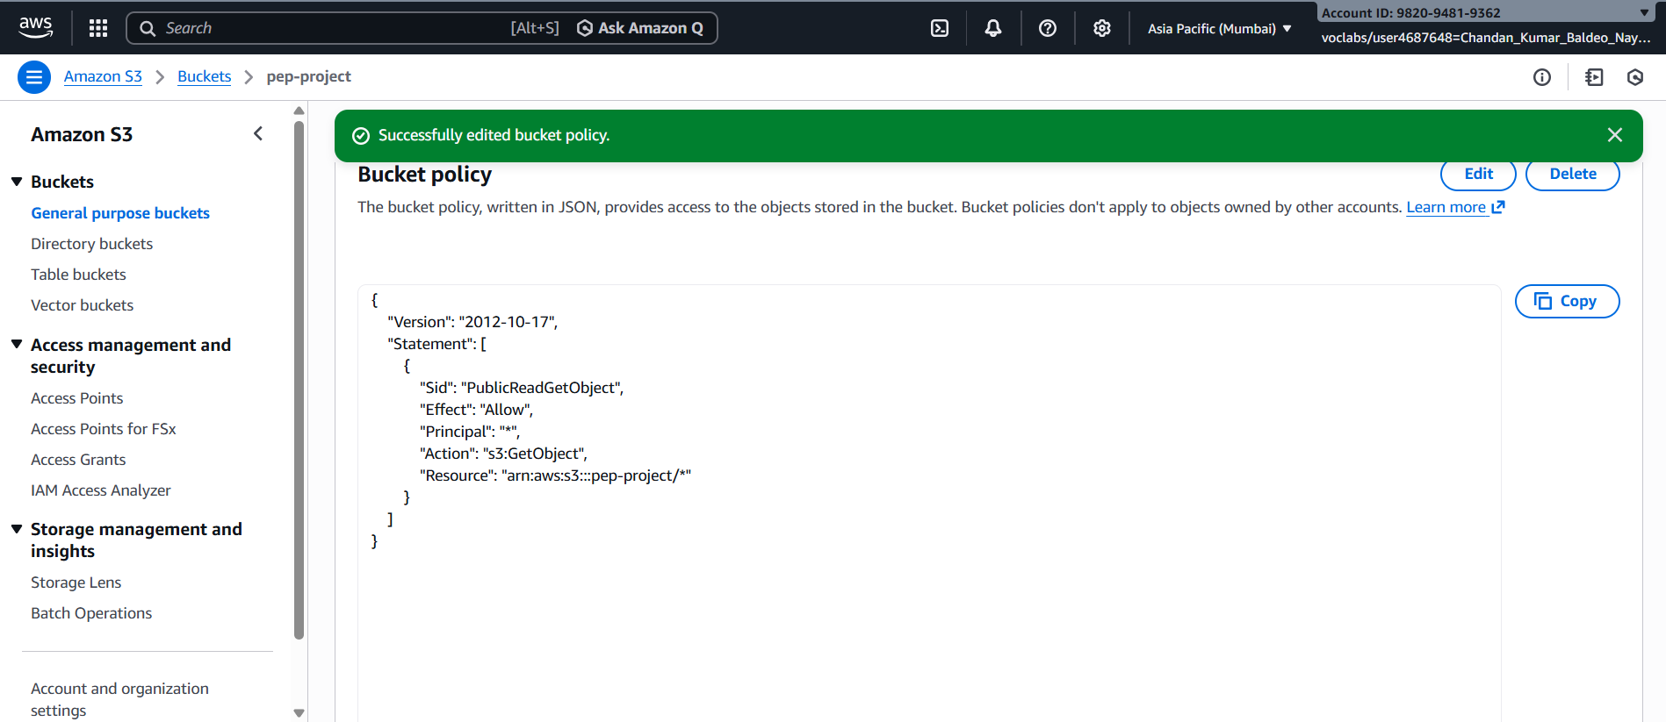

STEP 4: PUBLIC ACCESS

Slide 13
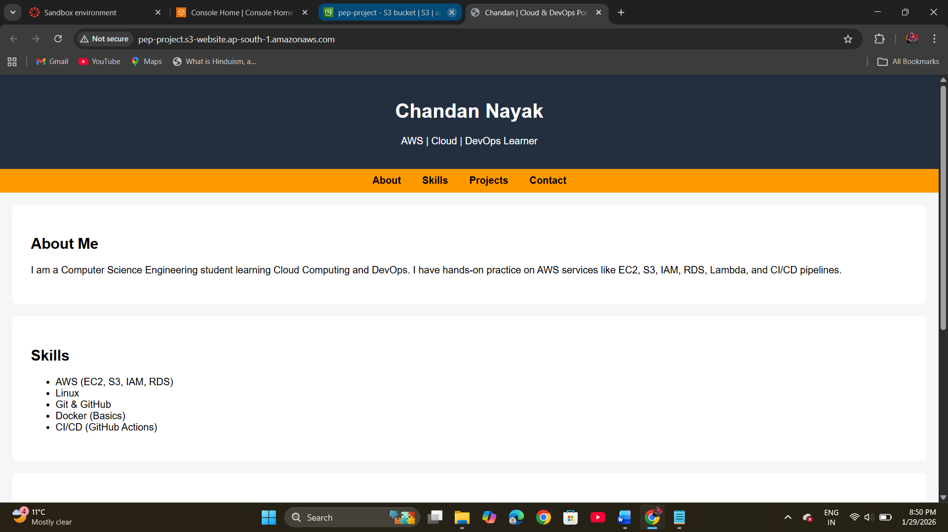
STEP 5: OUTPUT

Slide 14
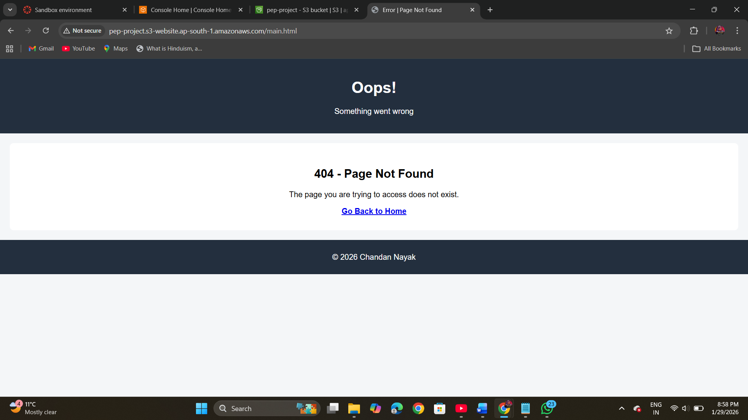

Slide 15
CONCLUSION
Amazon S3 provides a robust, low-cost, and maintenance-free solution for static hosting. By eliminating infrastructure management, developers can focus entirely on content and user experience.

Slide 16
Thank You!

